Slide 1


VISIPLATE Vehicle Number Plate Recognition in Foggy Weather Conditions
Presented by : Vriddhi Jain
And Aadya Sinha
Mentor : DR. Sanchali Das University : Bennett University (Department of Computer Science)

Slide 2

PROBLEM STATEMENT
Poor visibility due to fog severely affects traffic surveillance.
Currently only research papers have been written no such implementation.
Leads to security risks, missed detections, and disrupted law enforcement.
Need for a weather-resilient, intelligent detection system.

Slide 3

PROJECT OBJECTIVE
Develop a system to accurately identify number plates in foggy conditions.
Use real-time CCTV input for detection.
Apply deep learning and image processing to enhance clarity.
Build an efficient and scalable solution for real-world deployment.

Slide 4

PROPOSED SOLUTION
Integrate CCTV camera feed with software to capture vehicle images.
Use image dehazing techniques to clean foggy frames.
Apply CNN-based detection using TensorFlow and PyTorch.
Processed number plate is extracted and displayed both real time and static.

Slide 5
TECHNOLOGIES USED
Programming Language: Python
Libraries Used: DehazeNet (realtime model)
OpenCV (cv2) – image processing
TensorFlow & PyTorch – CNN model building
Pillow – image manipulation
Architecture: Multi-layer CNN
Hardware Input: CCTV camera

Slide 6

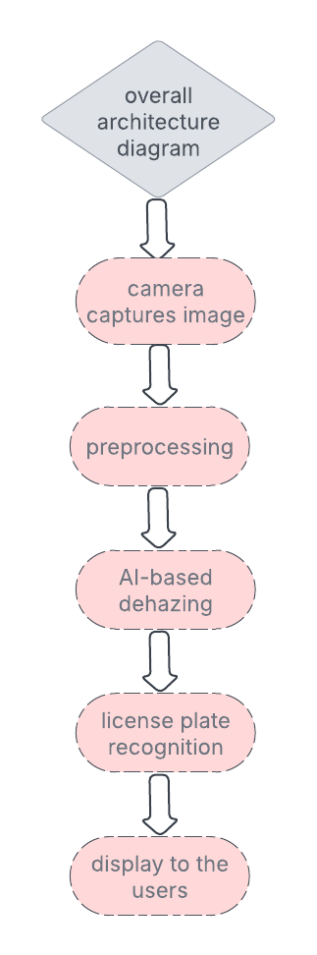
ARCHITECTURE DIAGRAM

Slide 7
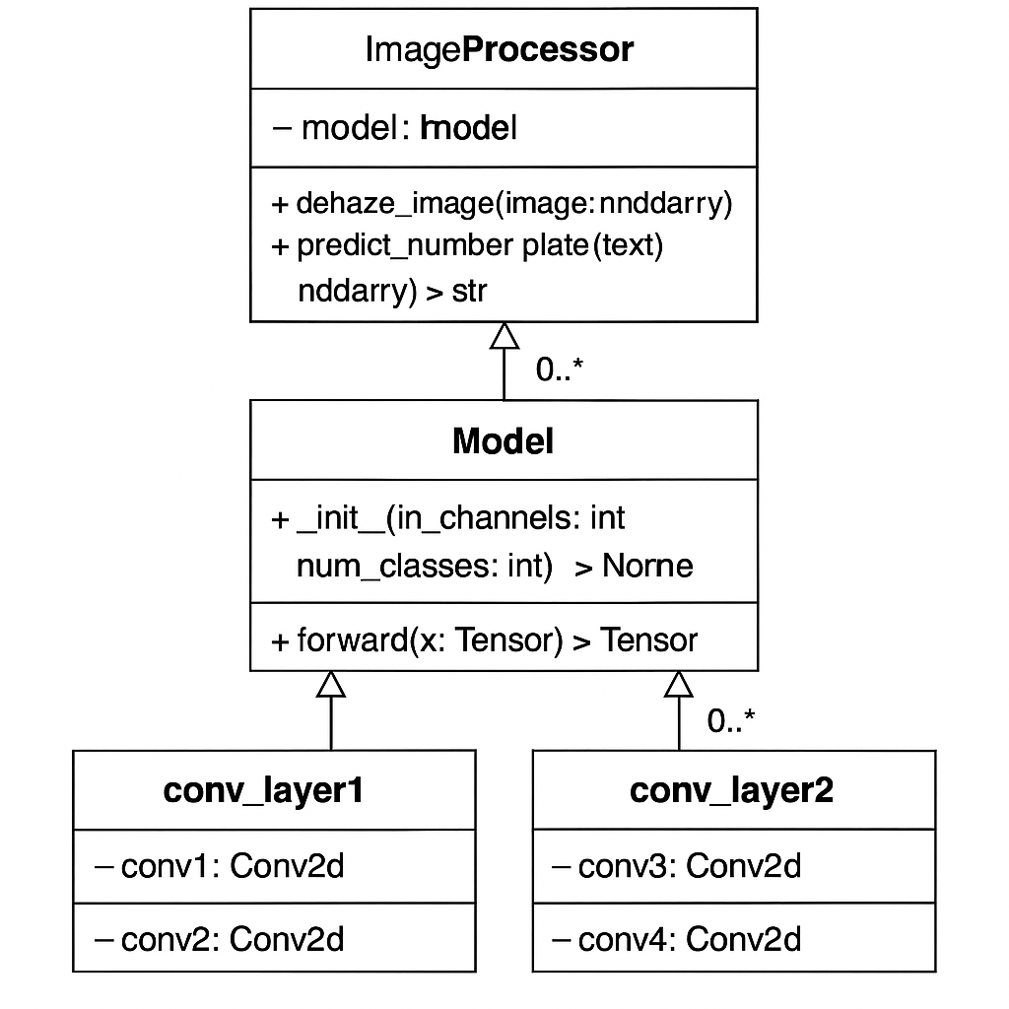
Classes used
Main Classes:
Defogger: Enhances images
CNNModel: Trained to detect plates
FrameProcessor: Handles video input
ImageSaver: Saves clean plate image

Slide 8
PSEUDOCODE LOGIC
Step 1: Capture image from CCTV.
Step 2: Apply dark channel prior and estimate atmospheric light.
Step 3: Refine image using guided filtering.
Step 4: Use CNN model to detect number plate.
Step 5: Does not save clean plate but only displays .

Slide 9
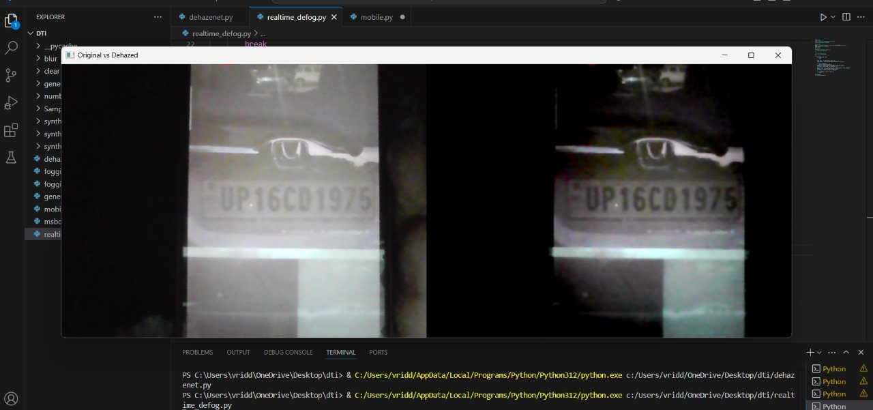
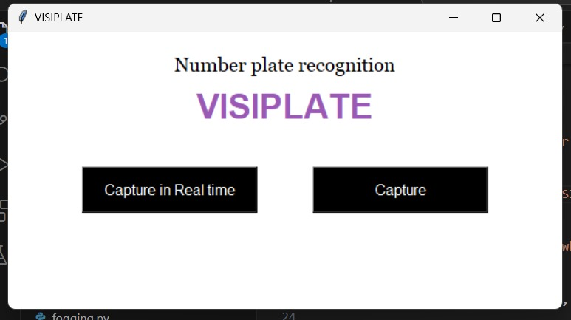
Output (samples)
Before (Foggy Image)
After (Dehazed Image with Number Plate Highlighted)
Detection is done automatically and accurately.

Slide 10
CONCLUSION AND FUTURE SCOPE
Successfully built a fog-resilient number plate detection system.
Accurate under varying fog conditions using deep learning and cv2.
Future Enhancements:
Add support for night/rainy weather
Able to embed it in any other device.

Slide 11

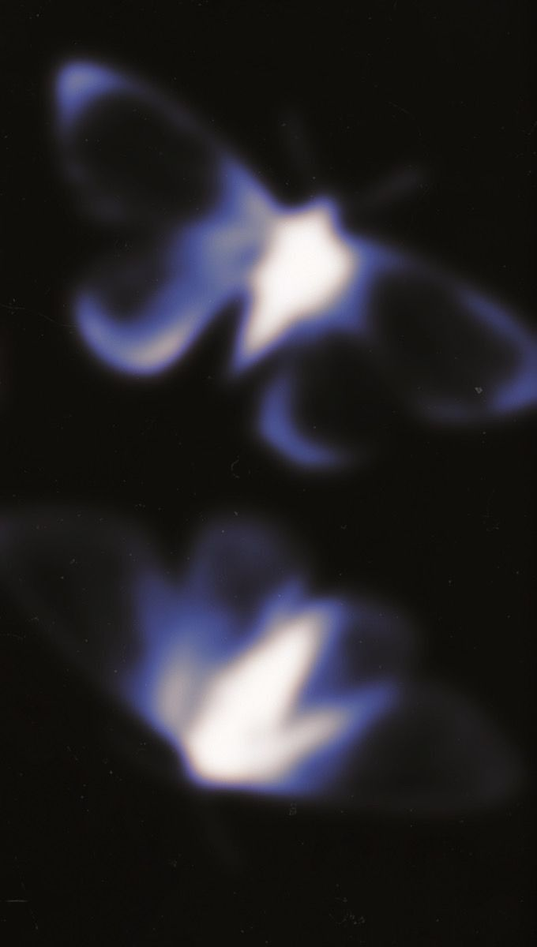


Presented by : Vriddhi Jain
And Aadya Sinha

